Slide 1
…
So I could talk about:
The Academy

Slide 2
…
So I could talk about:
The Academy
Friday Training

Slide 3
…
So I could talk about:
The Academy
Friday Training
Big Sis/Bro Scheme

Slide 4
…
AWS Certification roadmap Favouring group based deployments
Growing Best Practice
Building Excellence via Eze
Good Security is Good Software
CI Testing pipelines Azure and GCP training
…

Slide 5
…
Or…
the ideas behind it all

Slide 6
…
Now for something completely different

Slide 7


Kickoff Talk
“Anatomy of Success”
Anthony McKale
Principal Engineer
20/05/2022

Slide 8
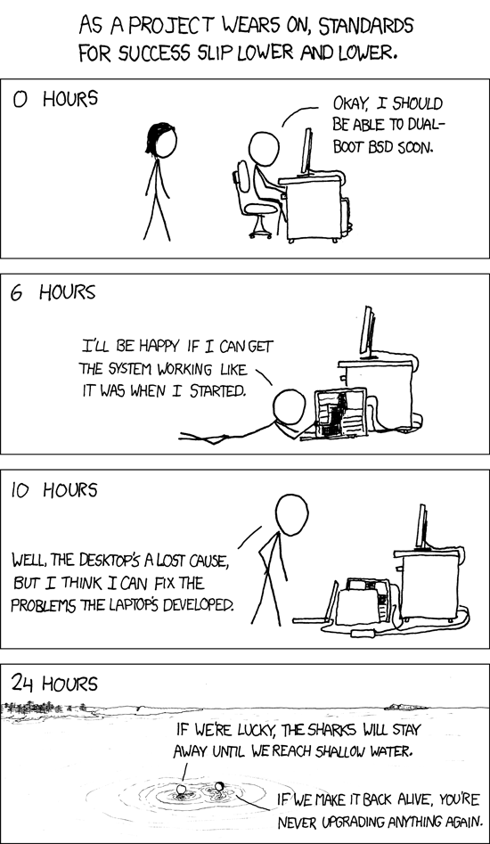
Intro: Success
https://xkcd.com/349/

Slide 9
Intro: Success
What is success ?

Slide 10
Intro: Success
What do you want :
Big House
Big Car
Attractive partner

Slide 11
Intro: Success
What do you want :
Grand achievements at Work
Grand achievements in Hobbies

Slide 12
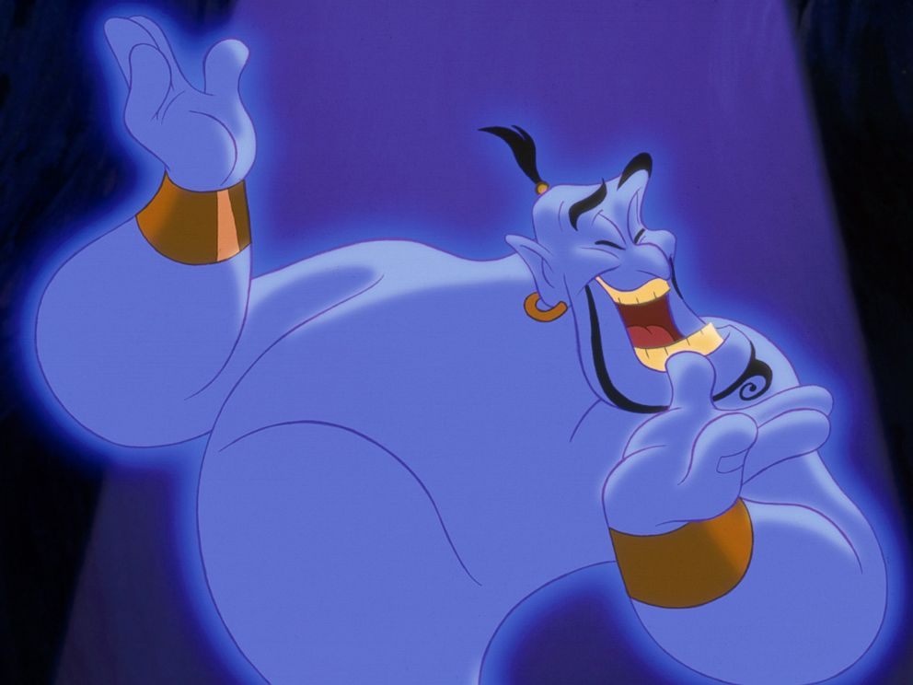
Intro: Success
What do you want :
Unbridled fame and
fortune ?
https://www.google.com/search?q=genie+alladin+fame+and+fortune&tbm=isch&ved=2ahUKEwjhp6yGse33AhVE9IUKHfPaBLsQ2-cCegQIABAA&oq=genie+alladin+fame+and+fortune&gs_lcp=CgNpbWcQAzoFCAAQgAQ6BggAEB4QCDoECAAQHjoGCAAQChAYUJQDWIUZYMgaaABwAHgAgAGgAYgBxBGSAQQzLjE1mAEAoAEBqgELZ3dzLXdpei1pbWfAAQE&sclient=img&ei=GyyHYqGuMMTolwTztZPYCw&bih=722&biw=1536&rlz=1C1CHBF_en-GBGB945GB945#imgrc=YbQcECOBApVdsM&imgdii=2fGLJtdG6ANskM

Slide 13
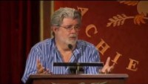
Intro: Joy vs Pleasure
0 – 90 sec
Please
Watch
Fullclip
Yourselves!
https://www.youtube.com/watch?v=CnHyStDZ3_U

Slide 14
Intro: Success is joy
Success is a type of joy
Happiness through working on something of value

Slide 15
Intro: Success is joy
Questions ?
What: Joy from working on valuable things
then examples

Slide 16
Success: Examples
Vanity section, a bit about me

Slide 17
Success: Examples
I’m older, wiser, and happier than my younger self
Here’s some of my successes at work

Slide 18
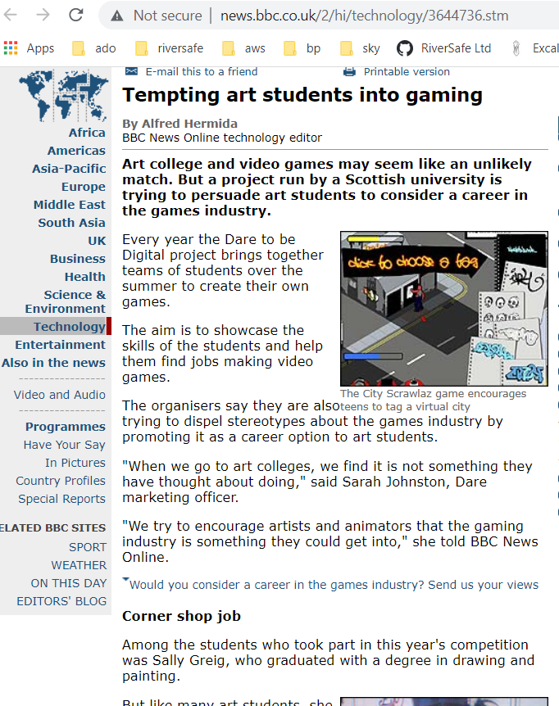
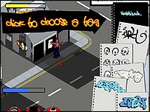
Success: Examples
Winning Dare to be Digital 2004
City Scrawlaz
https://www.google.com/search?q=City+Scrawlaz

Slide 19
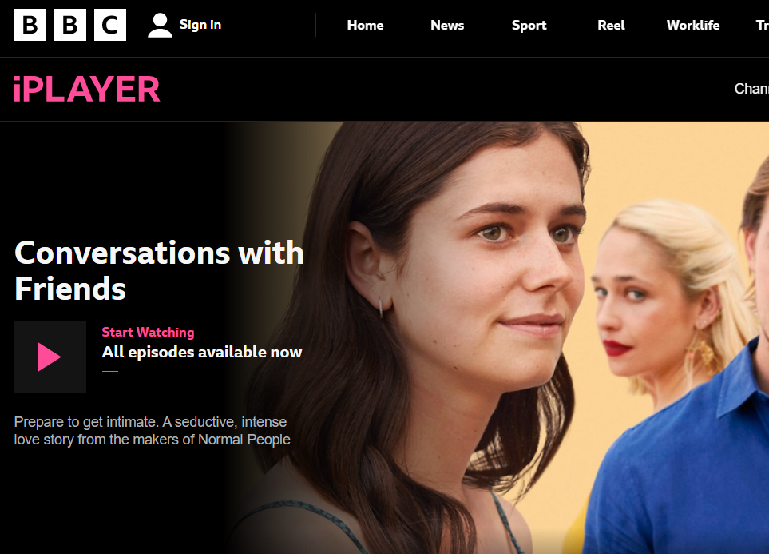
Success: Examples
Building the first version of iPlayer with a bunch of guys in 10 weeks…

Slide 20

Success: Examples
Winning Bafta for Education Projects

Slide 21
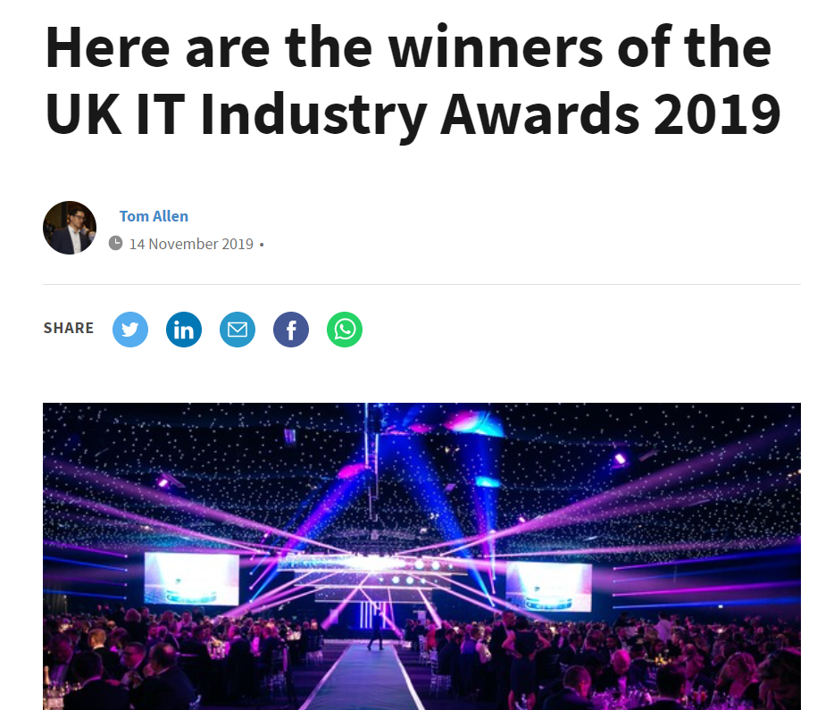
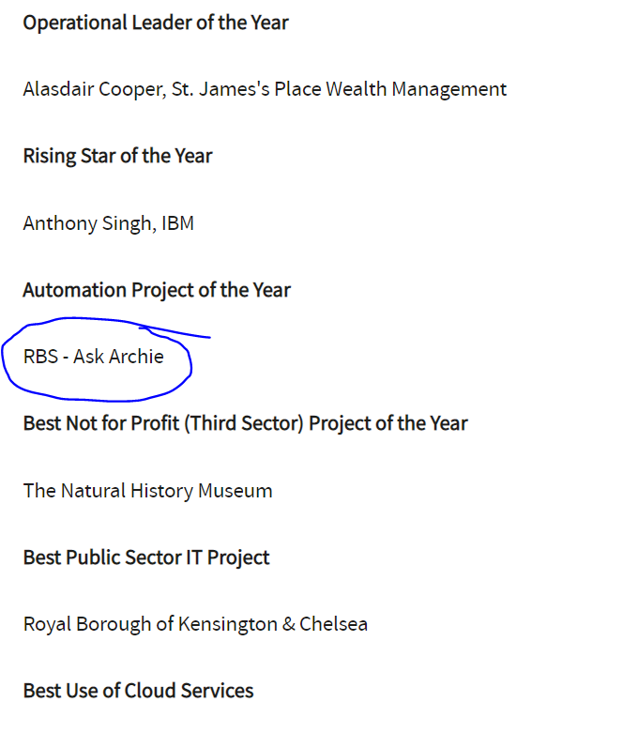
Success: Examples
Technical Feats in AI: with Cora / Ask Archie
:https://www.computing.co.uk/news/3083722/here-are-the-winners-of-the-uk-it-industry-awards-2019

Slide 22
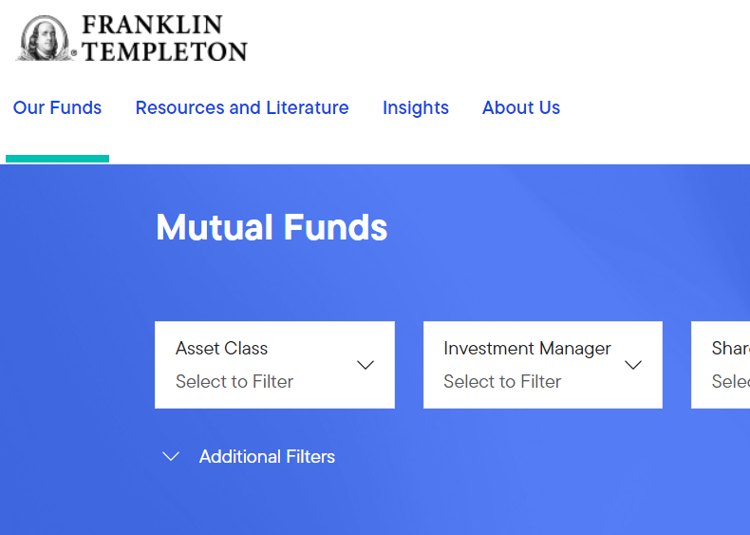
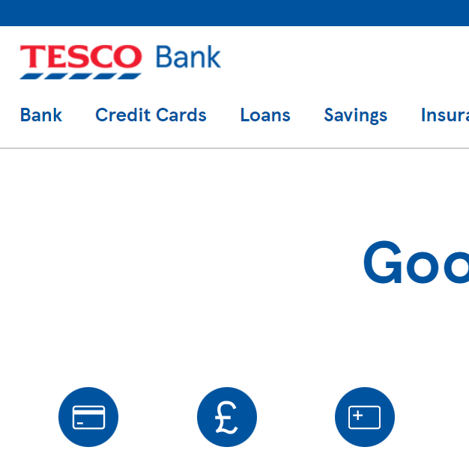

Success: Examples
And a lot more…

Slide 23
Success: Examples
Not trying to flex

Slide 24
Success: Examples
Just saying I’ve had and seen
SUCCESS and NOT-SUCCESS

Slide 25
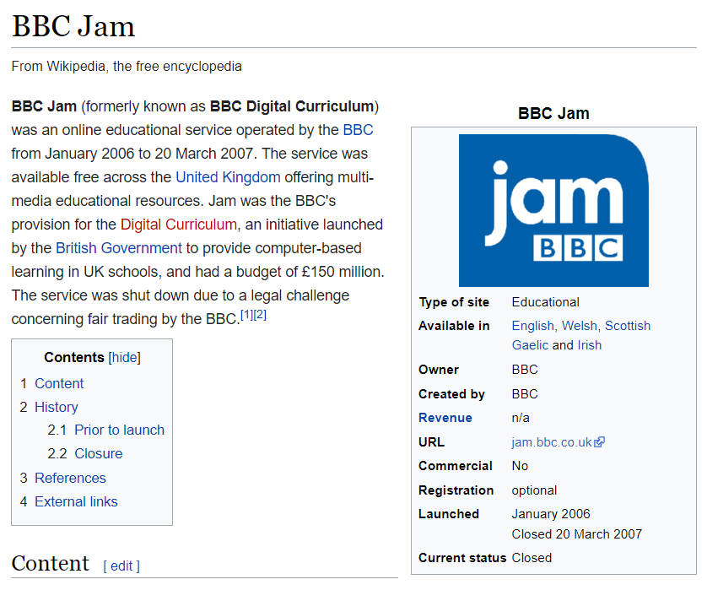
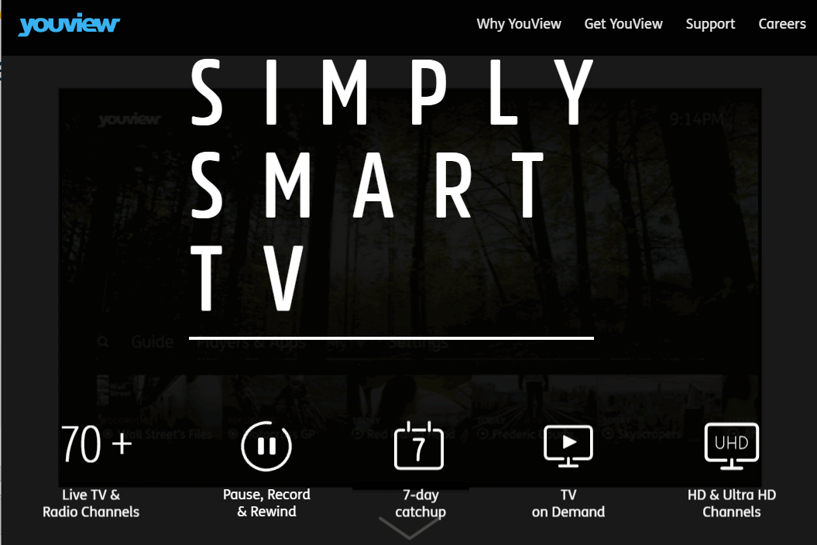
Success: Failures
Some less successful things
https://en.wikipedia.org/wiki/BBC_Jam

Slide 26
Success: Attributes
Common themes…

Slide 27
Success: Attributes
Small Teams
Clear Vision
Iterative Development Well bonded Teams

Slide 28
Success: The Pattern
There was a Pattern all the success I’ve seen or had All projects and teams had 4 things

Slide 29
Success: The Pattern
1) doing something we valued
Doesn’t need to be physically valued But everyone needs pride in themselves and there produce To give a damn, and not be checked out

Slide 30
Success: The Pattern
2) Everyone felt valued in their work
Not everyone was a genius / ninja coder but everyone appreciated each other and everyone pulled their weight*

Slide 31
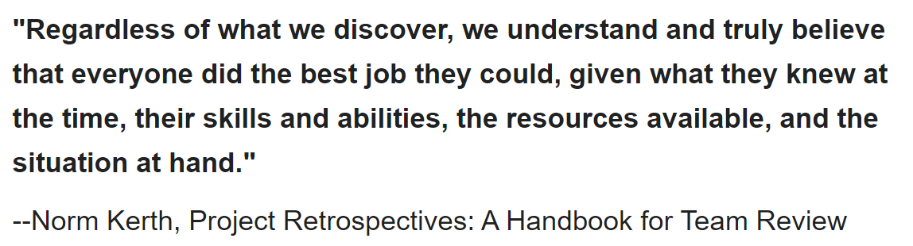
Success: The Pattern
* according to their abilities / experience / time Success is personal, Success is individual

Slide 32
Success: The Pattern
3) liked the people around us
Don’t need to go for drinks everyday But no crazy fights, no name calling, no judgement when mistakes happen We all supported each other (I’m even say cared about each other)

Slide 33
Success: The Pattern
4) sticking together through the bad until the good
All projects have good and bad moments
Successful teams don’t turn on themselves at the first bump in the road

Slide 34
Success: The Pattern
1. doing something of value
2. feeling valued
3. liking the people around you
4. sticking together through thick and thin
5. ... repeat
6. profit success

Slide 35
Success: Success comes from good teams
Questions ?
What: Joy from working on valuable things How: Good teams, working together
Onto Examples
then examples

Slide 36
Success: Examples
Enough about coding
lets talk personal

Slide 37
Success: Pattern
1. doing something of value
2. feeling valued
3. liking the people around you
4. sticking through good / bad
5. ... repeat
6. profit success

Slide 38
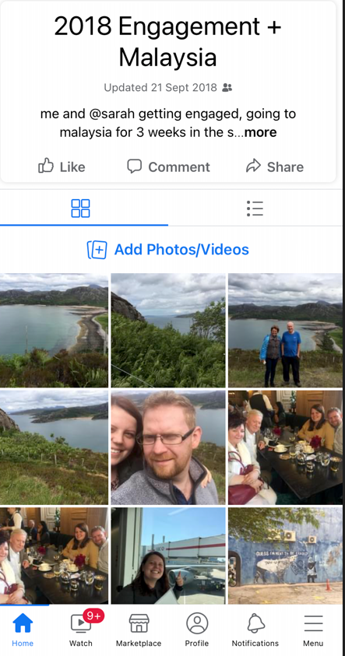
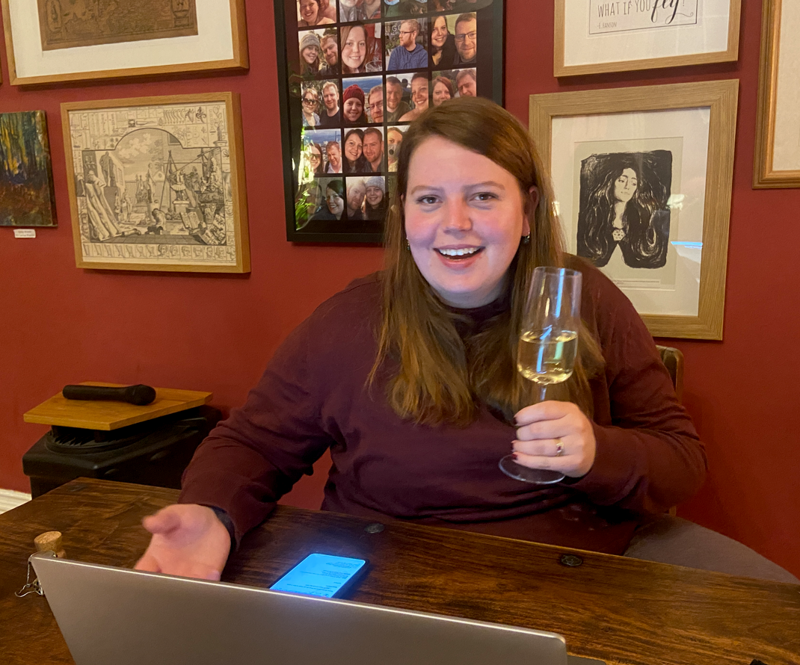
Success: Examples
step 1) find and propose someone amazing

Slide 39
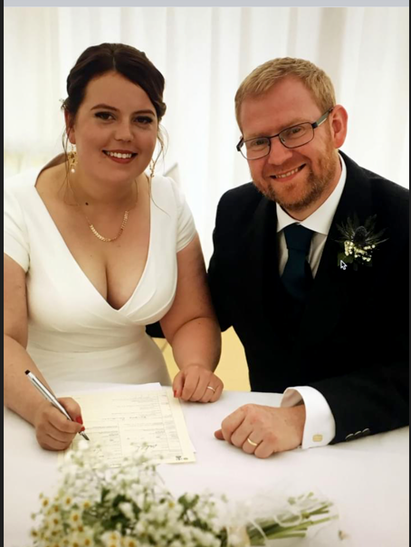
Success: Examples
step 2) plan wonderful wedding

Slide 40
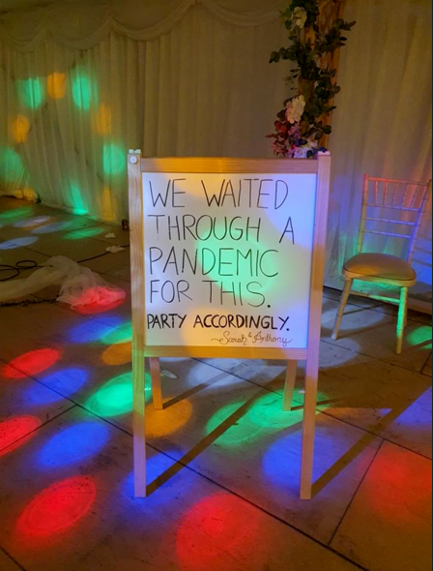
Success: Examples
step 2) cough plus a year delay for some reason

Slide 41
Success: Examples
Step 3) plan the most amazing multi country 1 month holiday for 2022 Enjoy the time together after 2 years of planning and stress

Slide 42
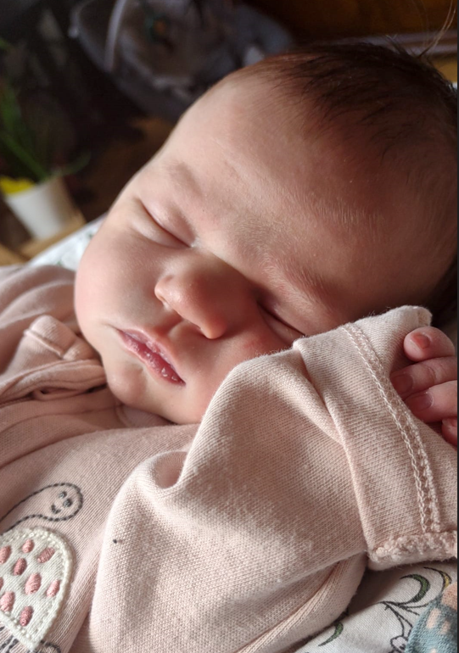
Success: Examples
Step 3) or add a new team member

Slide 43
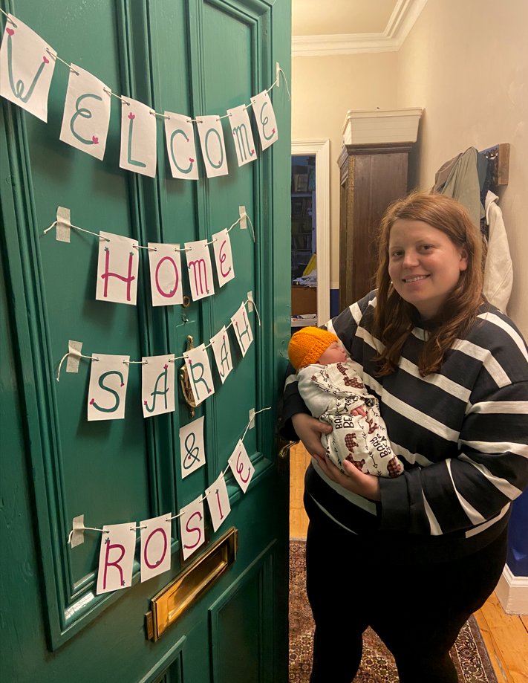
Success: Examples
Step 3) or add a new team member

Slide 44
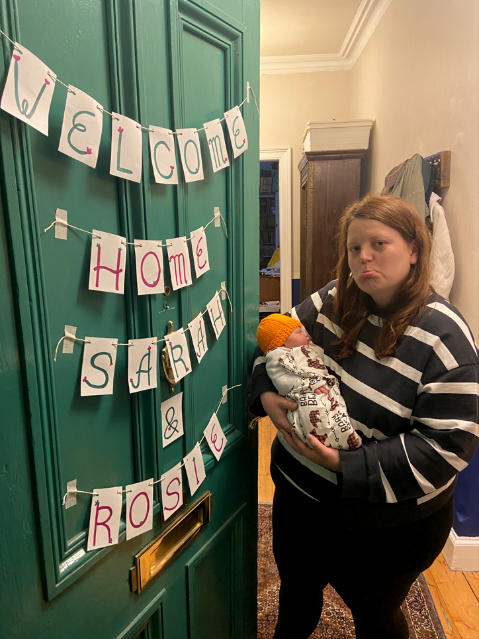
Success: Examples
Step 4) then
2 days later leave for “work” At a 5 star hotel
In Malaga

Slide 45
Success: The Pattern
1. doing something of value Hell yes
2. feeling valued Every day
3. liking the people around you Yup, Even the smelly new one
4. sticking through good / bad And it was worth every moment

Slide 46
Success: Heimdall
Enough about me
lets talk about Liam

Slide 47
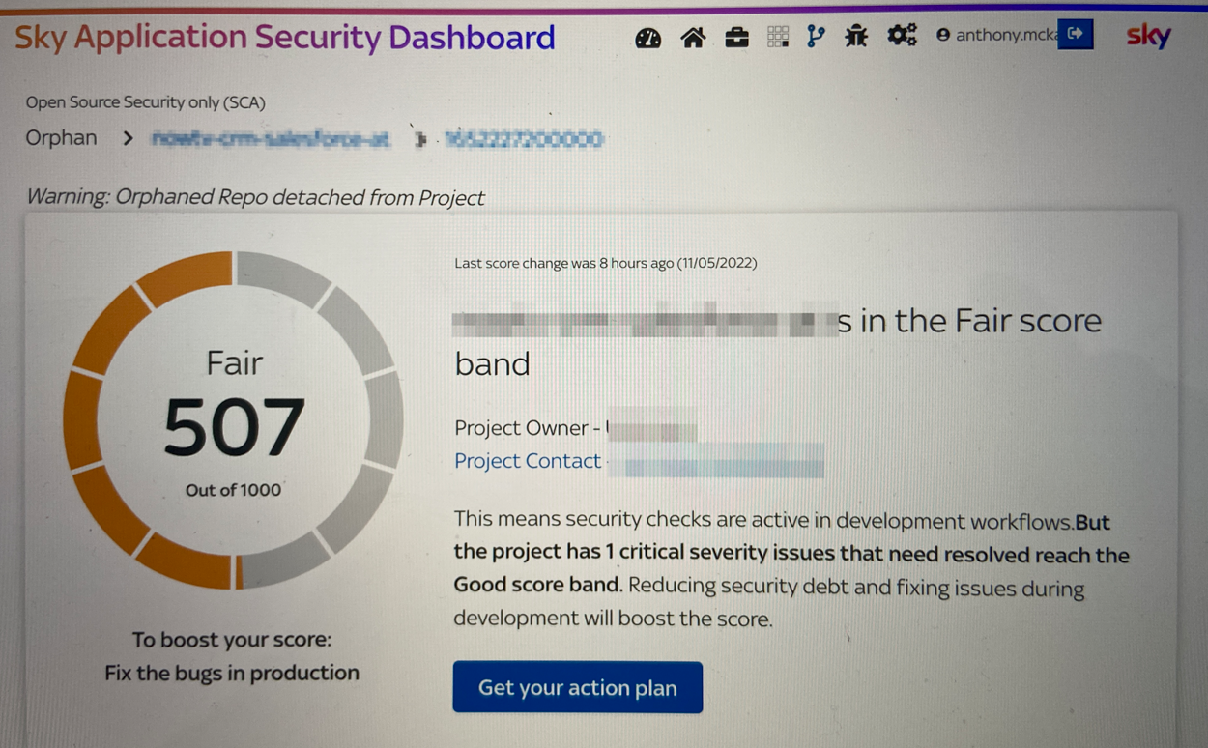
Success: Heimdall

Slide 48
Success: Heimdall
Heimdall is a internal security scanning tool for:
Every project in sky
Every repo in sky
Every team in sky

Slide 49
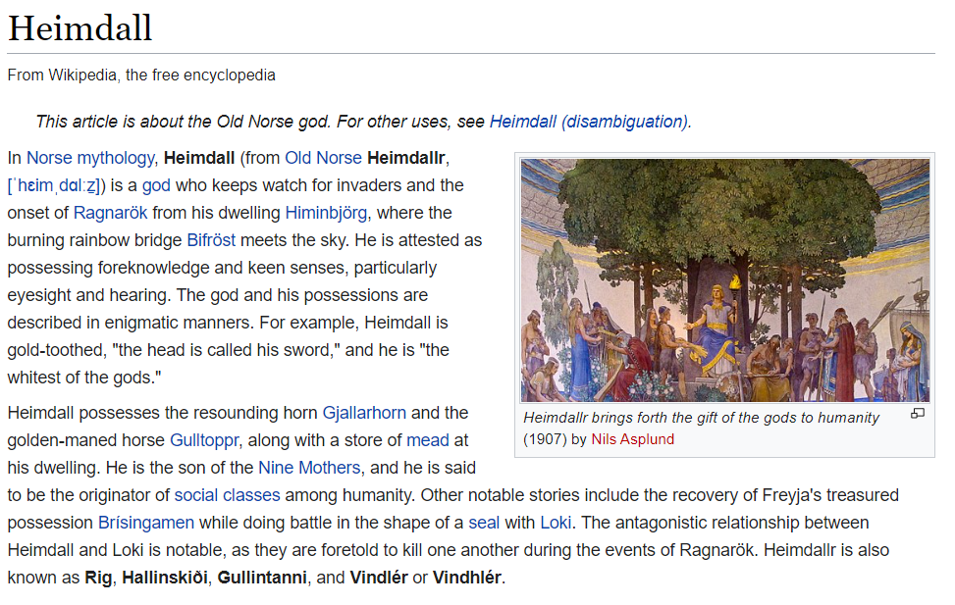
Success: Heimdall
Heimdall Sky Project
in just a few months the team has created…

Slide 50
Success: Heimdall
large fully featured react website
DB managing thousands of project’s
Backend systems for ingesting / scanning thousands of projects

Slide 51
Success: The Pattern
1. doing something of value Most definitely
2. feeling valued Everyday, we know/told it’s important and success breeds more features requests ☺
3. liking the people around you Yup, it’s a great team
4. sticking through good / bad It’s had highs and lows, but it’s working great and I’m so proud

Slide 52
Success: We have Success
Questions ?
What: Joy from working on valuable things How: Good teams, working together Here: Good people, doing good things

Slide 53
Success for next project
Hopefully these observations and musings help you find success at work and life
Success is working with others to find joy
Ta Anthony

Slide 54
Questions
I’ve been Anthony “Zapper” M^{c}Kale
Hopefully I’ve Educated, Informed, and even Entertained Good Testing is Good Security is Good software

Slide 55
Thank you

